Slide 1












CSC358: Principles of Computer Networks
Lecture 1: Introduction
mobile network
4G
national or global ISP
Streaming
video
Skype
IP
local or regional ISP
home network
content
provider
network
HTTP
datacenter
network
Ethernet
TCP
enterprise
network
Erfan Meskar
Winter 2025, University of Toronto, Mississauga

Slide 2
Today’s Outline
What is the Internet made of?
How does the Internet work?
What is a protocol?
Layering
Sharing

Slide 3
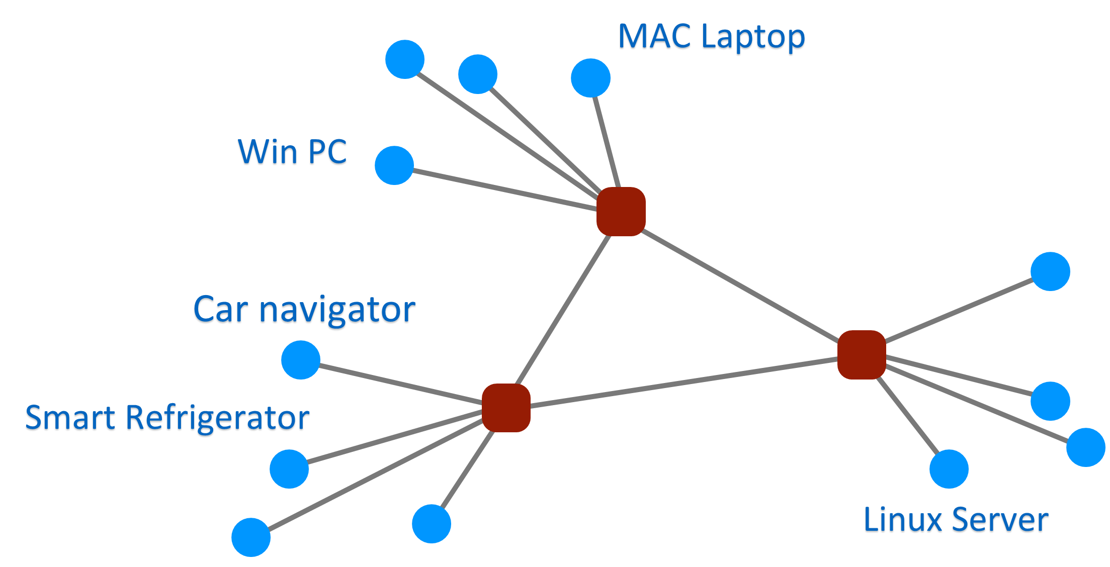
What is a Network Made of?
Three main components of a network
End-systems/End-hosts/End-points: send & receive data

Slide 4
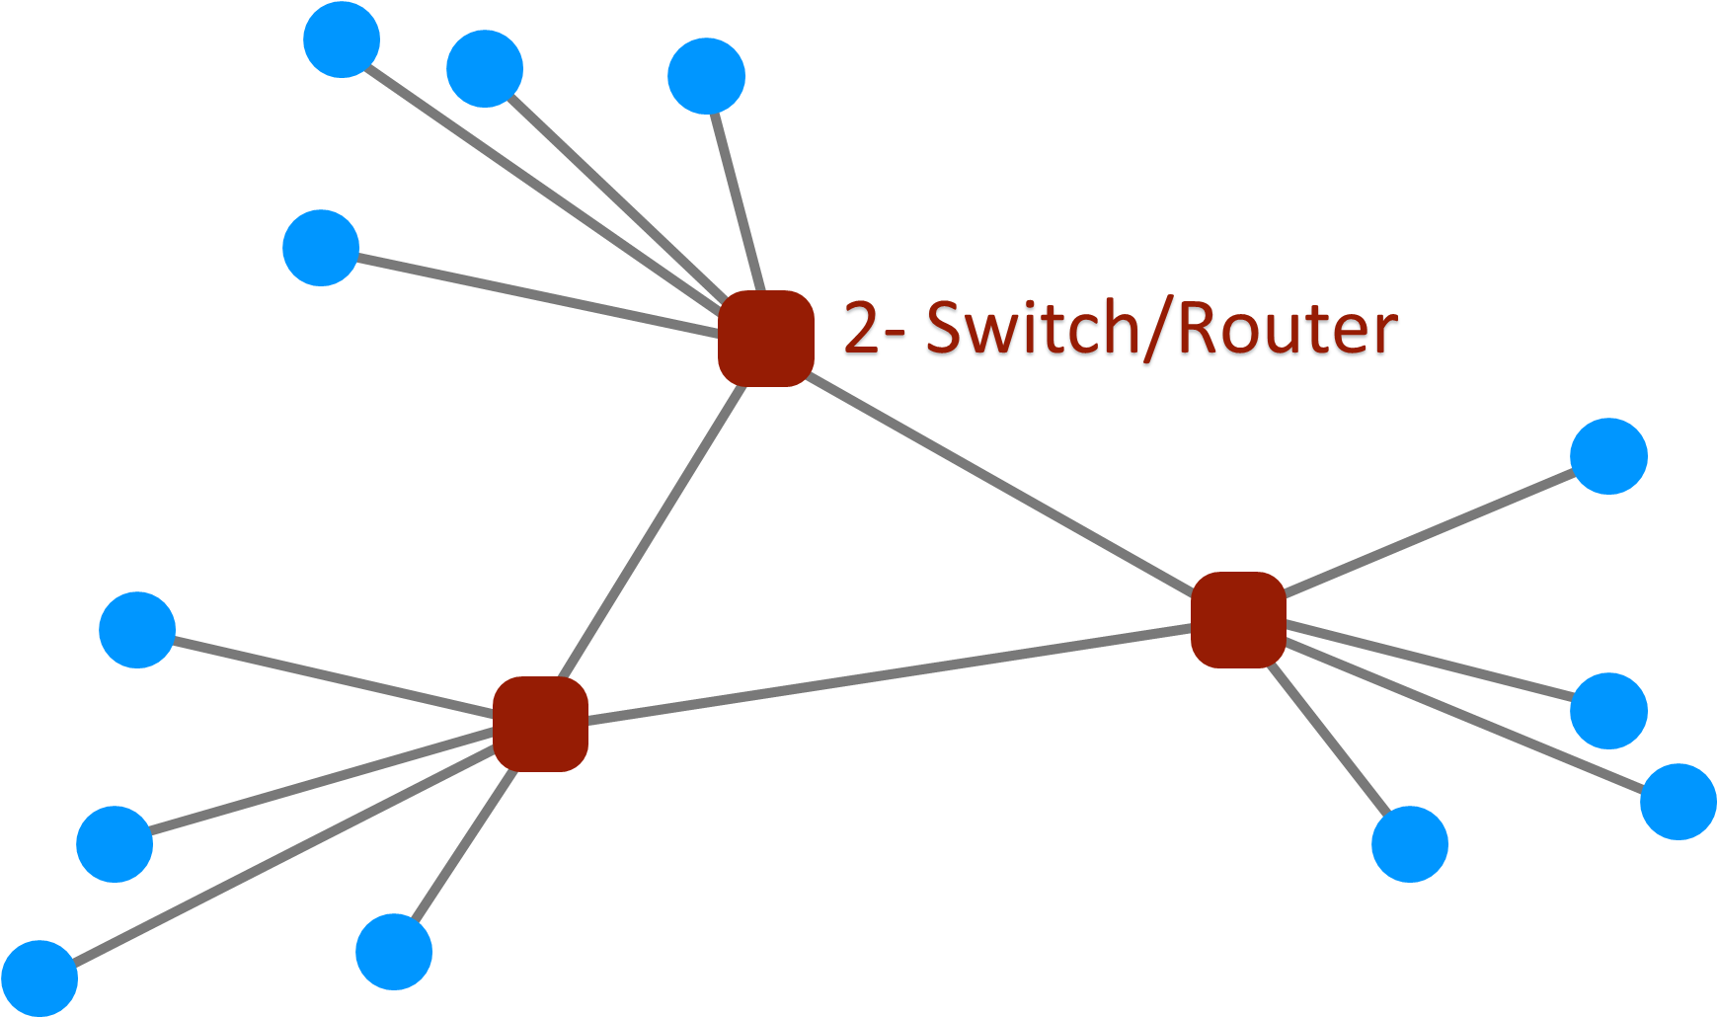
What is a Network Made of?
Three main components of a network
End-systems/End-hosts/End-points: send & receive data
Switches & routers: devices that forward data to the destination

Slide 5
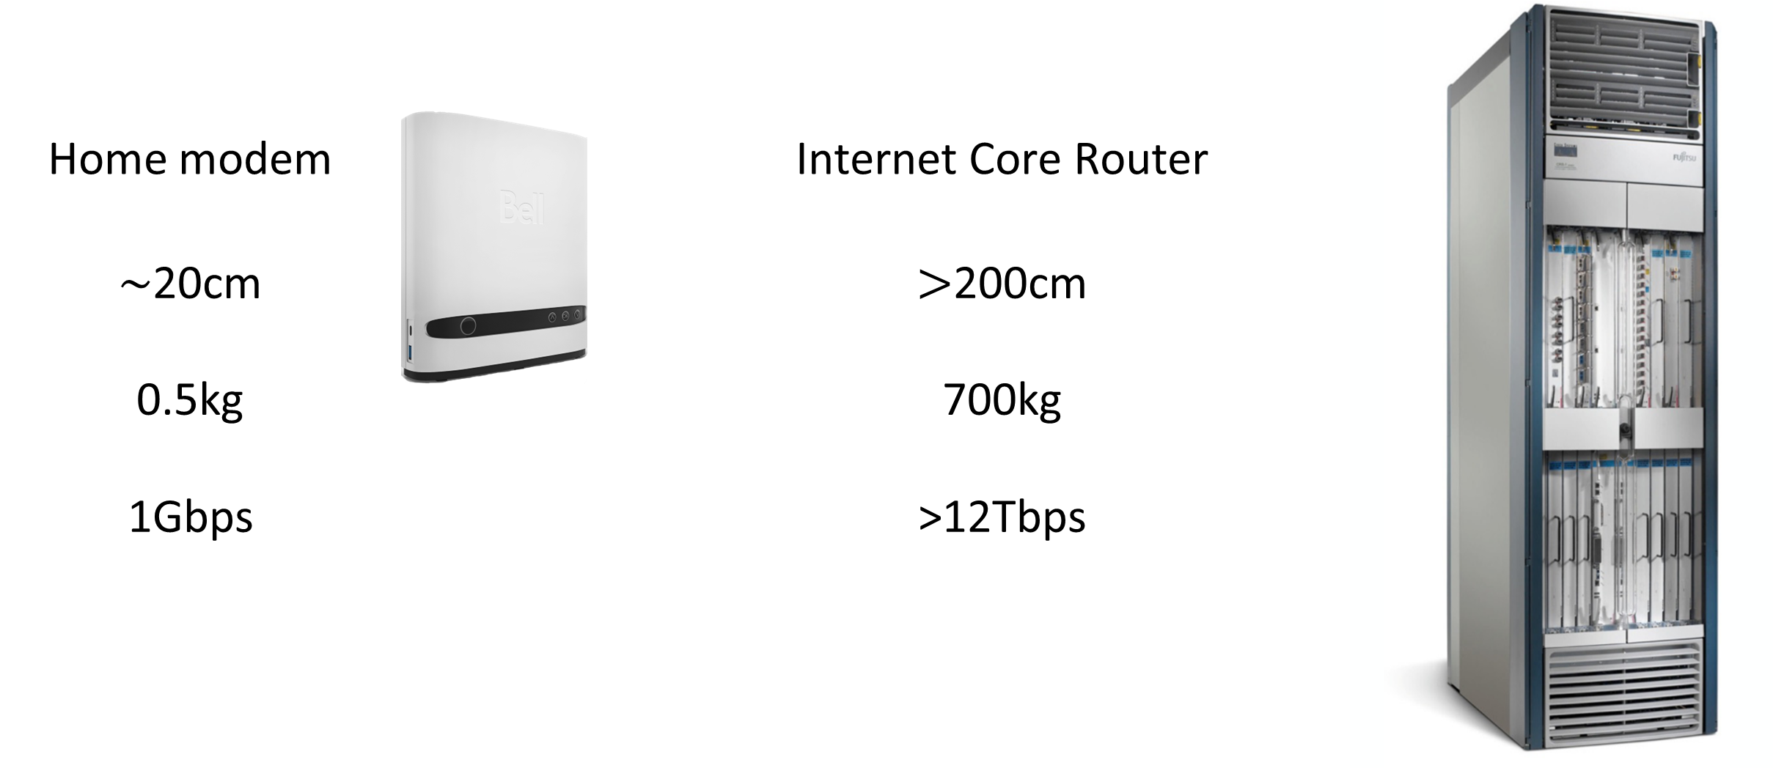
Switches and Routers

Slide 6
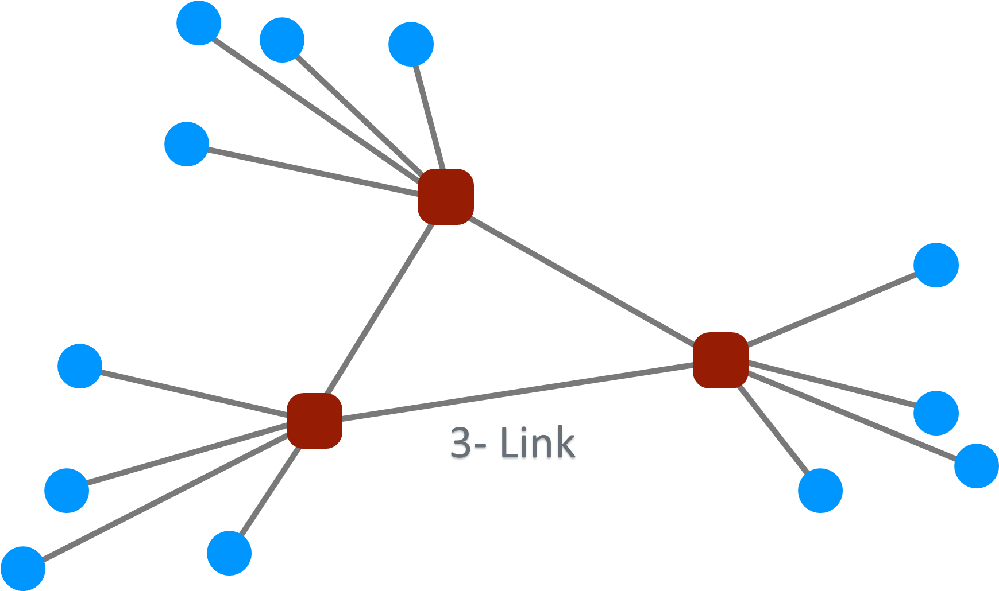
What is a Network Made of?
Three main components of a network
End-systems: send & receive data
Switches & routers forward data to the destination
Links connect end-systems and switches

Slide 7
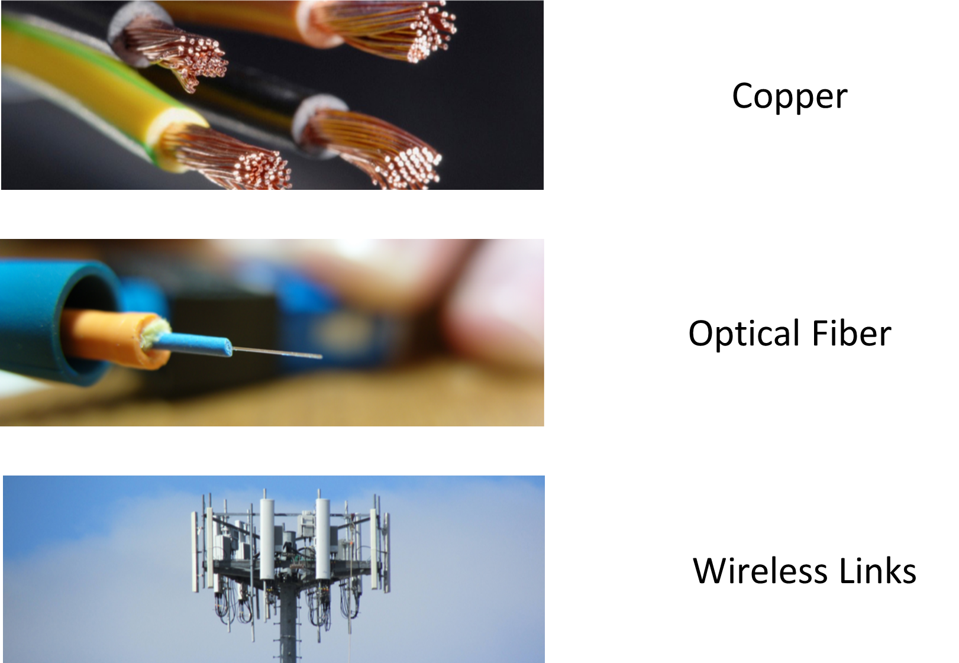
Different Types of Links for Different Usages

Slide 8
Today’s Outline
What is the Internet made of?
How does the Internet work?
The Internet is similar to the mail delivery system
What is a protocol?
Layering
Sharing

Slide 9
Mail System
U Toronto
McGill U
Alice
Bob

Slide 10

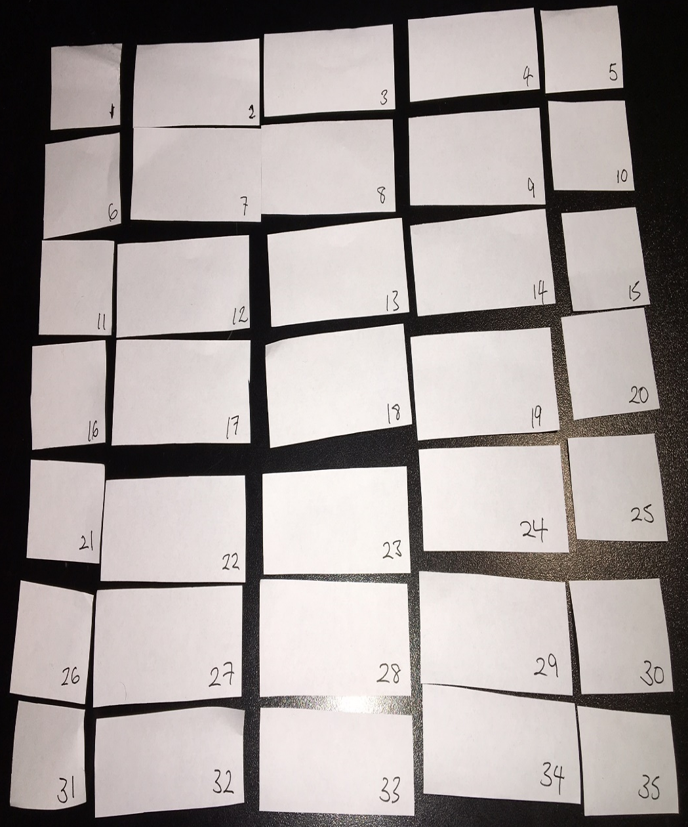
Poor Mona Lisa Cannot Fit into an Envelope

Slide 11





A More Accurate Model
From
Address
From: Alice, 40 St. George, Toronto
To
Address
To: Bob, 102 Main St., Montreal, QC
Alice
Bob

Slide 12
Multiple Envelope in Pipeline at the Same Time
From: Alice, 40 St. George, Toronto
From: Alice, 40 St. George, Toronto
From: Alice, 40 St. George, Toronto
To: Bob, 102 Main St., Montreal, QC
From: Alice, 40 St. George, Toronto
To: Bob, 102 Main St., Montreal, QC
To: Bob, 102 Main St., Montreal, QC
From: Alice, 40 St. George, Toronto
To: Bob, 102 Main St., Montreal, QC
To: Bob, 102 Main St., Montreal, QC
Alice
Bob

Slide 13



Mail System
U of Toronto
McGill U
Alice
Bob
Secretary
Secretary

Slide 14
Characteristics of the Mail System
Each envelope is individually routed
No guarantee of delivery in sequence
No time guarantee for delivery
No guarantee of delivery at all!
Envelope may be lost

Slide 15
Internet is Similar to Mail System
cs.toronto.edu
www.cs.mcgill.ca
Alice
Bob
O.S.
Data
Header
Data
Header
O.S.
Packet

Slide 16
What is a Packet?
A Packet is a chunk of bits which has enough amount of information for it to be independently routed:
Payload: meaningful only to the endpoints
Bits from a file, video, etc.
Header: meaningful to the network and endpoint
What information must a header contain? The destination address!
Communication between a pair of end-hosts involves the transmission of multiple packets
“Flow”: stream of packets exchanged between two endpoints (more on this later in the course)

Slide 17

Packets May Be Damaged
?!%%*
Data
Data

Slide 18
Packets May Arrive Out of Order
1
2

Slide 19
Packets May Be Duplicated
Duplicate
Data
Data

Slide 20
They may not arrive at all!
Data
Data
Full

Slide 21


Summary So Far
Applications send and receive data in packets …
… over the Internet which is unreliable.

Slide 22
Summary So Far
Applications send and receive data in packets …
… over the Internet which is unreliable.
Packets are forwarded hop-by-hop based on the destination address

Slide 23
Characteristics of the Internet
Each packet is individually routed
No in-sequence delivery guarantee
No time guarantee for delivery
No guarantee of delivery at all!
No integrity guarantee of data
Packets may be duplicated
Packets can be fragmented (more on this in future)

Slide 24
Characteristics of the Internet
No in-sequence delivery guarantee
No time guarantee for delivery
No guarantee of delivery at all!
No integrity guarantee of data
Packets can be fragmented
Packets may be duplicated
The Internet cannot be trusted!
It just makes a “best-effort” attempt

Slide 25
How to be Reliable Over the Unreliable Internet
The end-to-end principle:
We want to keep the intermediary network devices as simple as possible.
Complex operations should be implemented at the end-points rather than in the intermediary network devices
So, end-hosts must ensure that all packets are correctly delivered.
We acknowledge the delivery. But, acknowledging what and how?
If we do not receive the acknowledgement, we retransmit
How to determine when to retransmit? Timeout?
Need local copies of contents of each packet. How long to keep each copy.
What if an acknowledgement is lost?

Slide 26
Today’s Outline
What is the Internet made of?
How does the Internet work?
What is a protocol?
Layering and encapsulation
Sharing

Slide 27



What’s a protocol?
A human protocol and a computer network protocol:
Hi
TCP connection
request
Hi
TCP connection
response
Got the
time?
GET /path
Host: http://cs.umass.edu
2:00
<file>
time

Slide 28
What’s a protocol?
Network protocols:
Govern interaction between computers (devices) rather than humans

Slide 29
What’s a protocol?
All communication activities on the Internet is governed by protocols
Protocols define the rules for:
… specific messages sent
… specific actions taken when message received, or other events
Protocols define the format, order of messages sent and received among network entities, and actions taken on message transmission, receipt

Slide 30
Today’s Outline
What is the Internet made of?
How does the Internet work?
What is a protocol?
Layering and encapsulation
Sharing

Slide 31
Protocol “layers” and reference models
Networks are complex, with many “pieces”:
hosts
routers
links of various media
applications
protocols
hardware, software
Question:
is there any hope of organizing structure of network? and/or our discussion of networks?

Slide 32
Example: organization of air travel
end-to-end transfer of person plus baggage
ticket (purchase)
baggage (check)
gates (load)
runway takeoff
airplane routing
ticket (complain)
baggage (claim)
gates (unload)
runway landing
airplane routing
airplane routing
How would you define/discuss the system of airline travel?

Slide 33
Example: organization of air travel
ticket (purchase)
baggage (check)
gates (load)
runway takeoff
airplane routing
ticketing service
ticket (complain)
baggage (claim)
gates (unload)
runway landing
airplane routing
baggage service
gate service
runway service
routing service
airplane routing
layers: each layer implements a service
via its own internal-layer actions
relying on services provided by layer below

Slide 34
Why layering?
Layering is an approach to designing/discussing complex systems:
Explicit structure allows identifying relationship of system’s pieces
Modularization eases maintenance and updating of system
change in layer's service implementation: transparent to rest of system applications
e.g., change in gate procedure doesn’t affect rest of system

Slide 35
An Introduction to the Internet
cs.toronto.edu
www.cs.mcgill.ca
Application Layer
Alice
Bob
Transport Layer
O.S.
Data
Header
Data
Header
O.S.
Packet
Network Layer
Link Layer

Slide 36
Layering in the Internet
Link Layer
Carries data over (usually) point-to-point links between hosts and routers; or between routers and routers.
Network Layer
Provides “best-effort”, but unreliable, delivery of packets.
Transport Layer
Provides reliable, in-sequence delivery of data from end-to-end on behalf of application.

Slide 37
Layered Internet protocol stack
application: supporting network applications
HTTP, IMAP, SMTP, DNS
transport: process-process data transfer
TCP, UDP
network: routing of datagrams from source to destination
IP, routing protocols
link: data transfer between neighboring network elements
Ethernet, 802.11 (WiFi), PPP
physical: bits “on the wire”
application
application
transport
transport
network
network
link
link
physical
physical

Slide 38
Services, Layering and Encapsulation
application
transport
network
link
physical
M
application
transport
network
link
physical
Application exchanges messages to implement some application service using services of transport layer
H_{t}
M
Transport-layer protocol transfers M (e.g., reliably) from one process to another, using services of network layer
transport-layer protocol encapsulates application-layer message, M, with transport-layer header H_{t} to create a transport-layer segment
H_{t} used by transport layer protocol to implement its service
source
destination

Slide 39
Services, Layering and Encapsulation
application
transport
network
link
physical
M
application
transport
network
link
physical
H_{t}
M
Transport-layer protocol transfers M (e.g., reliably) from one process to another, using services of network layer
H_{n}
H_{t}
M
Network-layer protocol transfers transport-layer segment [H_{t} | M] from one host to another, using link layer services
network-layer protocol encapsulates transport-layer segment [H_{t} | M] with network-layer header H_{n} to create a network-layer datagram/packet
H_{n} used by network layer protocol to implement its service
source
destination

Slide 40
Services, Layering and Encapsulation
application
transport
network
link
physical
M
application
transport
network
link
physical
H_{t}
M
H_{n}
H_{t}
M
Network-layer protocol transfers transport-layer segment [H_{t} | M] from one host to another, using link layer services
H_{l}
H_{n}
H_{t}
M
Link-layer protocol transfers datagram [H_{n}| [H_{t} |M] from host to neighboring host, using physical layer services
link-layer protocol encapsulates network datagram [H_{n}| [H_{t} |M], with link-layer header H_{l} to create a link-layer frame
source
destination

Slide 41





Encapsulation
Matryoshka dolls (stacking dolls)
message
segment
datagram
frame
Credit: https://dribbble.com/shots/7182188-Babushka-Boi
Notes:
Thanks to Nikko Bovornkeeratiroj, Phuthipong <phuthipong@cs.umass.edu>, for the stacking dolls idea and slides

Slide 42
Services, Layering and Encapsulation
application
transport
network
link
physical
application
transport
network
link
physical
message
M
M
segment
H_{t}
M
H_{t}
M
datagram
H_{n}
H_{t}
M
H_{n}
H_{t}
M
frame
H_{l}
H_{n}
H_{t}
M
H_{l}
H_{n}
H_{t}
M
source
destination

Slide 43
Encapsulation: an end-end view
message
M
application
transport
network
link
physical
source
segment
H_{t}
M
H_{t}
datagram
H_{n}
H_{t}
H_{n}
M
frame
H_{l}
H_{n}
H_{t}
M
link
physical
switch
destination
H_{n}
H_{t}
M
network
link
physical
M
application
transport
network
link
physical
H_{l}
H_{n}
H_{t}
M
H_{n}
H_{t}
M
H_{t}
M
H_{n}
H_{t}
M
H_{l}
H_{n}
H_{t}
M
router

Slide 44
The Classic Picture – OSI Model – The 7-Layer Model
Application – what users see, e.g., web page via HTTP
Presentation – crypto, conversion b/w representations ASCII/Binary
Session – can tie together multiple streams (e.g., audio & video)
Transport – creates a “pipe” to move data between applications
Network – sends packets across entire net., using routing
Data Link – sends frames, handles media access across links
Physical – sends individual bits

Slide 45
OSI Reference Model
(L7)
(L4)
(L3)
(L2)
Layer N+1
Service: abstraction provided to layer above
API: concrete way of using the service
Layer N
Protocol: rules for communication within same layer
Layer N uses the services provided by N-1 to implement its protocol and provide its own services
Layer N-1

Slide 46
A More Practical/Realistic Picture
7. Application
Service: user-facing application (e.g., HTTP, SSH, …)
Application-defined messages
Service: multiplexing applications
Reliable byte stream to the other node (TCP),
Unreliable datagram (UDP)
4. Transport
3. Network
Service: move packets to any other node in the network
IP: Unreliable, best-effort service model
2. Link
Service: move frames to other nodes across link (e.g., Ethernet, Wifi, …)
1. Physical
Service: move bits to other nodes across link (Electrical engineering problem)
Where do we handle, e.g., security, reliability, fairness?
Notes:
To explain this, I’m going to start in the middle
There are some cross-cutting challenges

Slide 47
4-layer Internet Model vs. 7-layer OSI Model
Application
Application
e.g., HTTP
Presentation
Transport
Session
e.g., TCP
Transport
e.g., IP
Network
Network
Link
e.g., Ethernet
Link
Physical
The 4-layer Internet model
The 7-layer OSI Model

Slide 48
Review: Layering
Separation of concerns
Break problem into separate parts
Solve each one independently
Abstract data from the layer above inside data from the layer below
“Encapsulation”
Different implementations at one “layer” use same interface
Allows independent evolution
Application
Transport
Network
Link

Slide 49
Today’s Outline
Mail delivery system and the Internet
What is the Internet made of?
What is a protocol?
Layering and encapsulation
How is a network shared?
Circuit switching
Packet switching
Statistical Multiplexing

Slide 50
Circuit Switching
It’s the method used used to be used by the telephone network.
A call has three phases:
Establish circuit from end-to-end (“dialing”),
Communicate,
Close circuit (“tear down”).
Originally, a circuit was an end-to-end physical wire.
Nowadays Previously, a circuit was like a virtual private wire:
each call has its own private, guaranteed data rate from end-to-end.
A
B
Source
Destination

Slide 51
Circuit Switching
Reservation establishes a “circuit” within a switch
switch
src
dst

Slide 52
Circuit Switching – Telephone Network
Each phone call is allocated 64kb/s. So, a 10Gb/s trunk line can carry about 156,000 calls.
Destination
“Callee”
Source
“Caller”
Central
Office
“C.O.”
Central
Office
“C.O.”
Trunk
Exchange

Slide 53

Timing in Circuit Switching
Data
Circuit establishment
Data transfer
time
Circuit teardown

Slide 54
Example of Poor Efficiency in Circuit Switching
The circuit is mostly idle due to traffic bursts
Circuit establishment
Data transfer
time
Circuit teardown

Slide 55
Example of Poor Efficiency in Circuit Switching
The circuit is used for a short amount of time
Information
time

Slide 56

Another problem of circuit switching
Circuit switching doesn’t “route around trouble”
A
B

Slide 57
Circuit Switching, Pros and Cons
Pros:
Predictable performance
once circuit is established, it provides simple/fast switching
Cons:
complexity of circuit setup/teardown
inefficient when traffic is bursty
circuit setup adds delay
switch fails -> its circuit(s) fails

Slide 58
Packet Switching
It’s the method used by the Internet
Each packet is individually route,
using the router’s local routing table
The routers maintain no per-flow state
Different packets may take different paths
Several packets may arrive for the same output link at the same time,
Therefore, a packet switch has buffers

Slide 59
Packet Switching
A
B
R2
Source
R1
R3
Destination
R4
C
switch
dst
Each packet contains destination (dst)
Each packet treated independently

Slide 60
Packet Switching
A
B
R2
Source
R1
R3
Destination
R4
C
switch
dst
Each packet contains destination (dst)
Each packet treated independently
With buffers to absorb transient overloads

Slide 61
Packet Switching – Simple Switch Model
“4”
Link 1, ingress
Choose
Egress
Link 1, egress
Link 2
Link 2, ingress
Choose
Egress
Link 2, egress
R1
“4”
Link 1
Link 3
Link 3, ingress
Choose
Egress
Link 3, egress
Link 4
Link 4, ingress
Choose
Egress
Link 4, egress

Slide 62
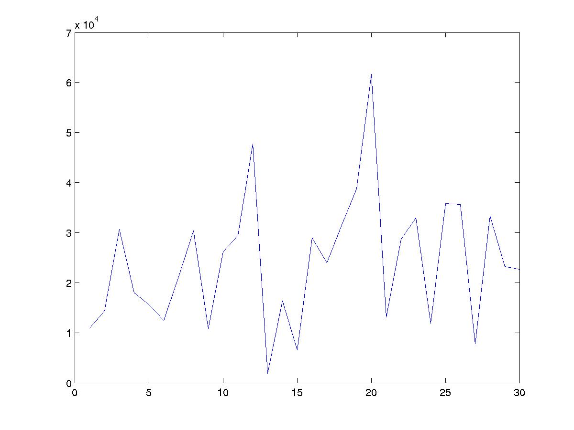
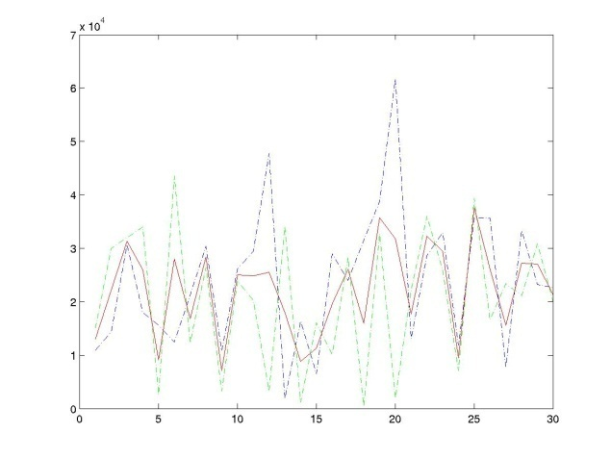
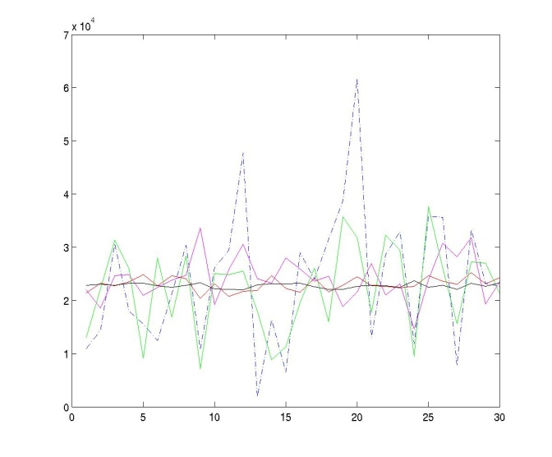
Statistical Multiplexing – Basic Idea
Network traffic is bursty, i.e., the rate changes frequently
Peaks from independent flows generally occur at different times
Conclusion: The more flows we have, the smoother the aggregate traffic.
One flow
Two flows
Many flows
Average rate
rate
Average rates of: 1, 2, 10, 100, 1000 flows.
time
time
time

Slide 63
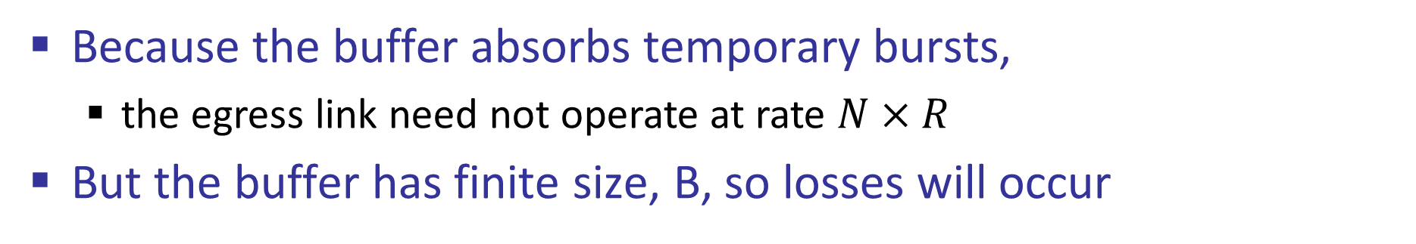
Packet Switching – Statistical Multiplexing
Because the buffer absorbs temporary bursts,
the egress link need not operate at rate $N×R$
But the buffer has finite size, B, so losses will occur
Packets for one output
Queue Length
X(t)
Dropped packets
Dropped packets
1
Data
Hdr
R
X(t)
B
2
Data
Hdr
R
Link rate, R
R
Packet buffer
N
Data
Hdr
Time

Slide 64
Statistical Multiplexing
Rate
A
C
A
C
time
Rate
B
C
B
C
time
Notes:
Statistical multiplexing
Important if traffic is bursty
Less expensive
Contention requires buffering
Variable delay => no QoS guarantees

Slide 65
Statistical Multiplexing Gain
A+B
Rate
2C
R < 2C
A
R
B
time
Statistical multiplexing gain = 2C/R
Other definitions of SMG: The ratio of rates that give rise to a particular queue occupancy, or particular loss probability.
Notes:
Statistical multiplexing
Important if traffic is bursty
Less expensive
Contention requires buffering
Variable delay => no QoS guarantees

Slide 66
Why Packet Switching in The Internet
Efficient use of expensive links:
The links are assumed to be expensive and scarce.
Packet switching allows many, bursty flows to share the same link efficiently.
“Circuit switching is rarely used for data networks, ... because of very inefficient use of the links” - Gallager
Resilience to failure of links & routers:
“For high reliability, ... [the Internet] was to be a datagram subnet, so if some lines and [routers] were destroyed, messages could be … rerouted” - Tanenbaum

Slide 67
Questions for the rest of the semester
Is layering the best approach?
Simplifies design
Yet, limited and inflexible
Best effort service
Made the rapid growth of the Internet possible
Makes providing any guarantees very difficult
Packet switching
Enables statistical multiplexing
We need extremely fast routers
Routing: How does a router know which output port to send the packet to?

